Slide 1


Alinma Bank Report
CS392 Software Engineering
Section : 371
Instruction :
Dr.Lamees Alhazzaa

Slide 2

Team Members
01
Dana Dhafer Alyami | 440022746
02
Leen Saleh Alaboudi | 440020514
03
Manar Mutlaq Alqabbani | 440022244
04
Mehaf Khaled Allazzam | 440021473

Slide 3


Out lines
01
02
03
04
05
Introduction
Clean code analysis
Security analysis
Design
Conclusion

Slide 4

01
Introduction

Slide 5


02
Clean code analysis

Slide 6


- Clean code analysis
not enough documentation, which make the code more difficult to understand.
they use more than one variable style so it difficult to read.
no vertical alignment, which make the code more difficult to read.
didn’t use proper data structure, they repeat the line many times
a lot of identifies are not meaningful so it’s not clear the purpose of it
some functions names are not meaningful so it’s difficult to tell what the function do
The names of some of the classes are meaningless and do not give an idea of ​​the content of the classes
Classes were not arranged clearly, which made it difficult to access specific classes

Slide 7
03
Security analysis

Slide 8
Security analysis
Critical
0-15
High
16-40
Risk calculation
Low
71-100
Medium
41-70

Slide 9
Manifest analysis
And code analysis

Slide 10


Design
GUI

Slide 11
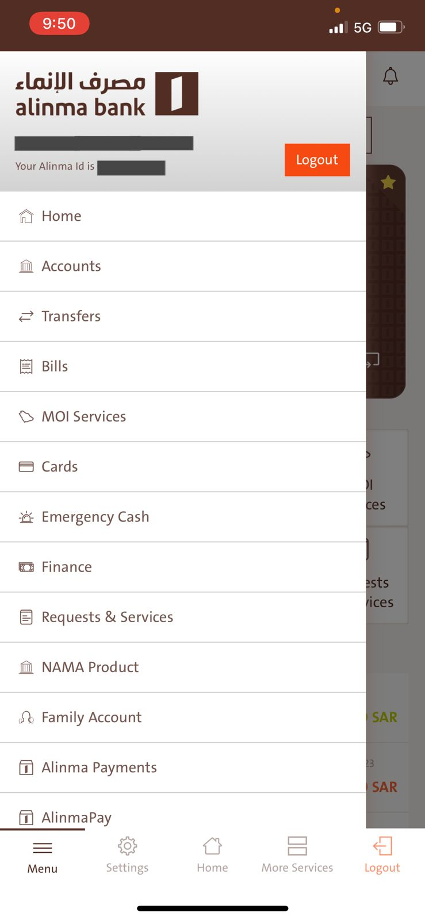
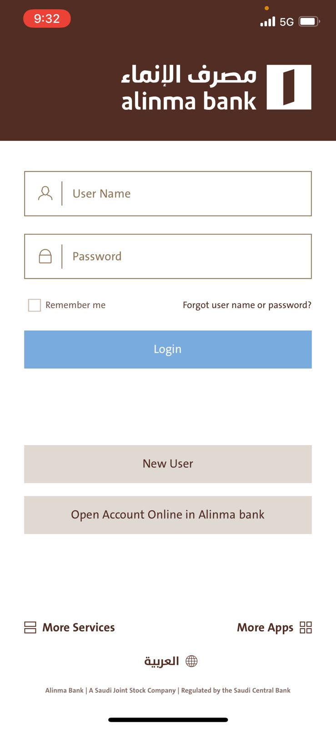
Design

Slide 12
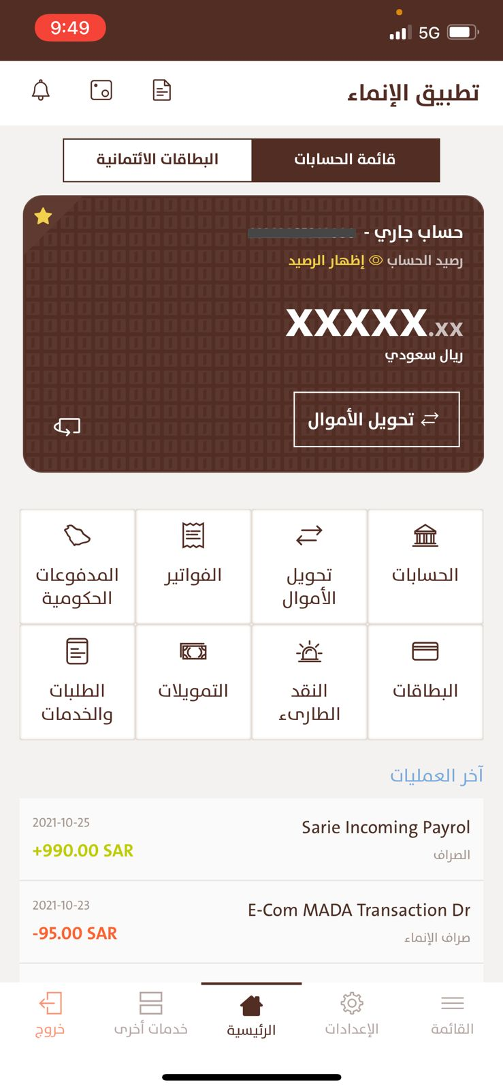
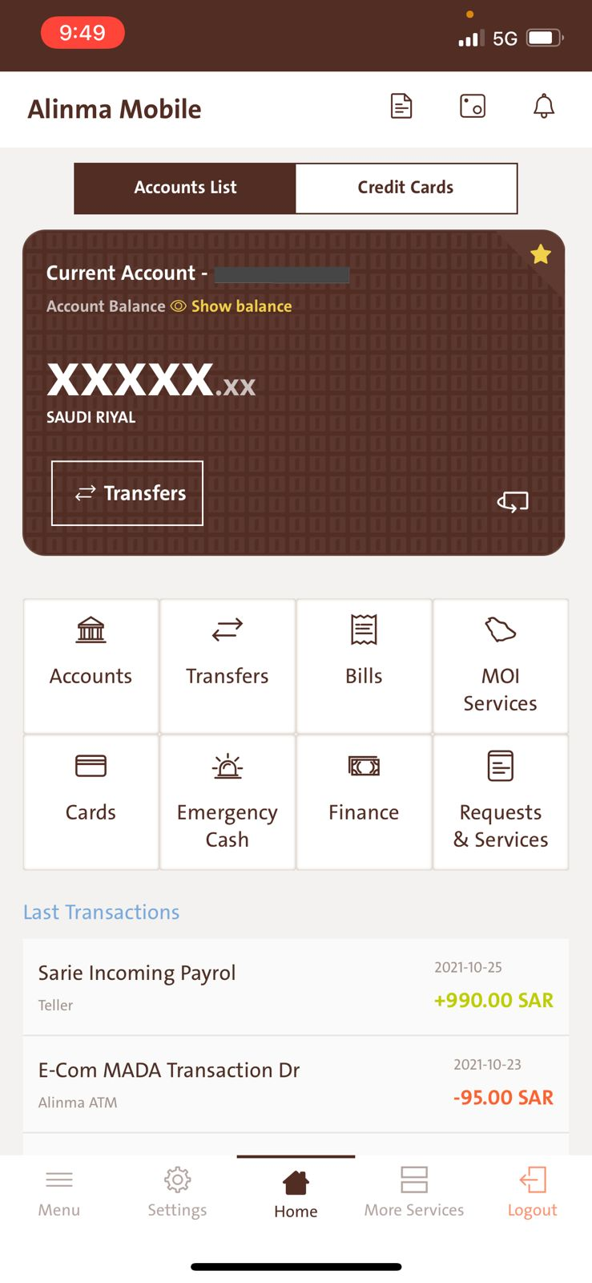

Slide 13
Internal
design

Slide 14


Conclusion
thank you for being attention !

